Slide 1

From Chicago to Springfield: Understanding Crime Rates and Emergency Service Costs in Illinois Cities
BY:
Amanda Baynard, Andrew Voortman, Corbin Moore, Sania Sufi & Shunjia Liu

Slide 2
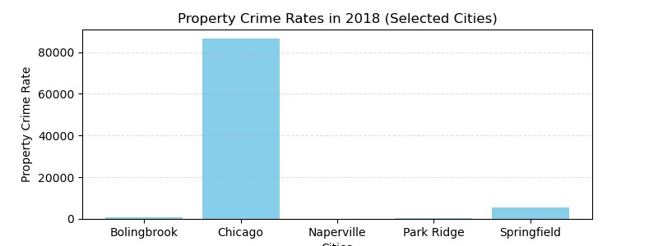
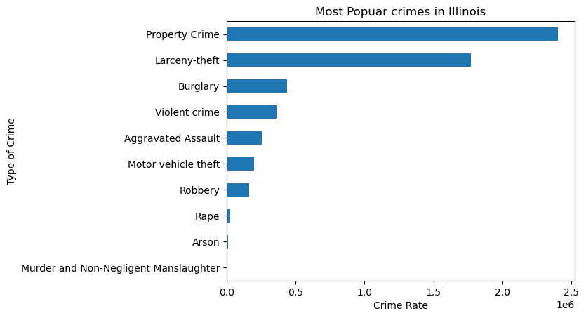
Most Popular Crimes in Illinois

Slide 3
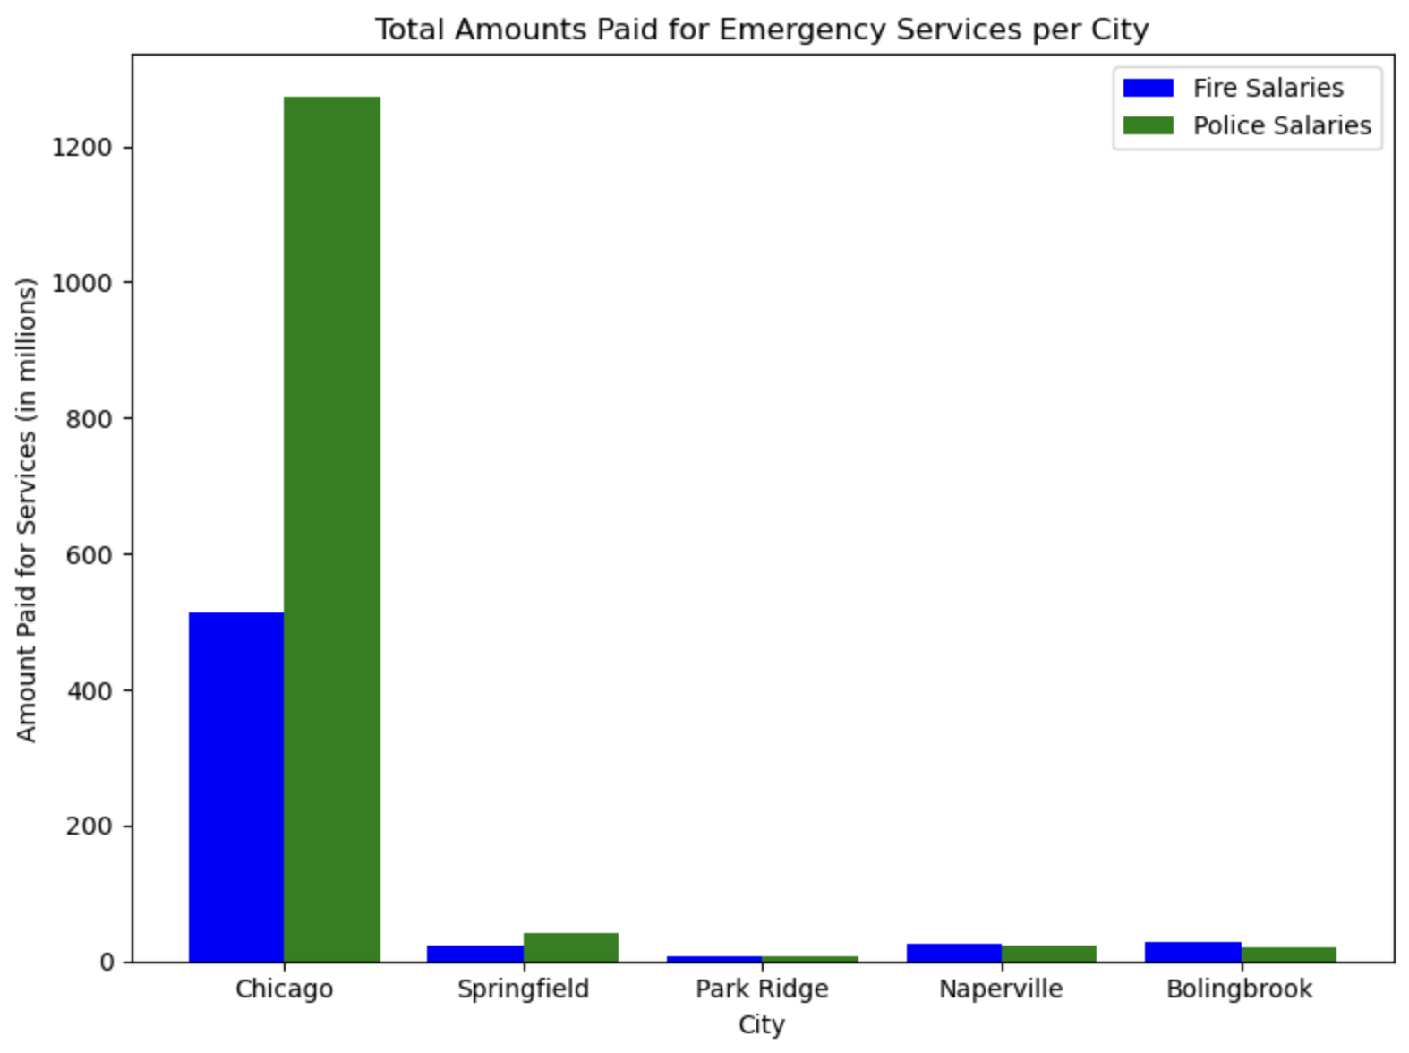
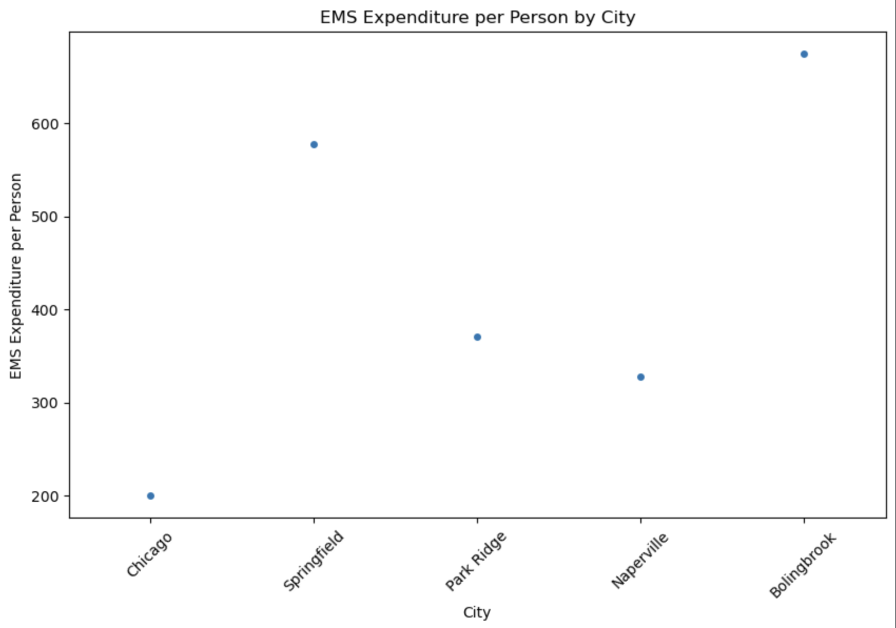
Emergency Services per City

Slide 4
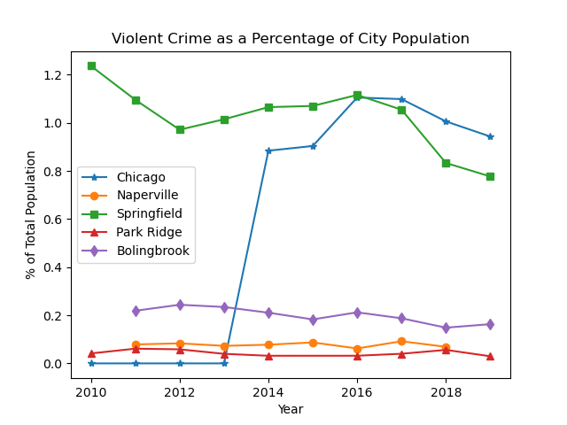
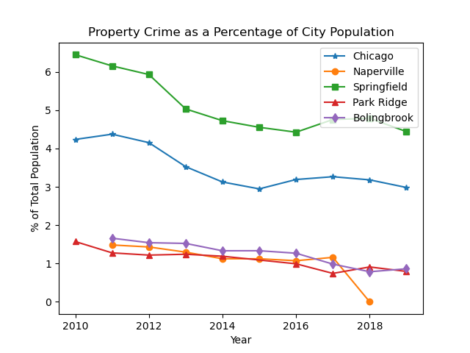
Breaking it down…

Slide 5
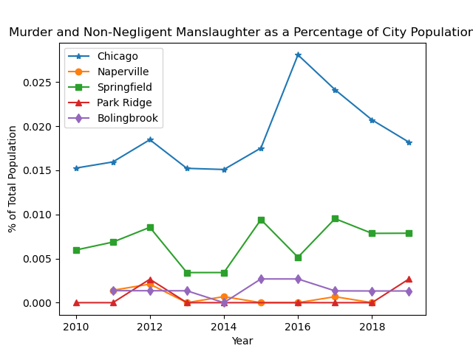
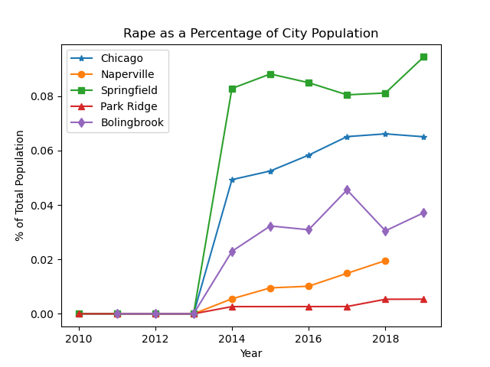

Slide 6
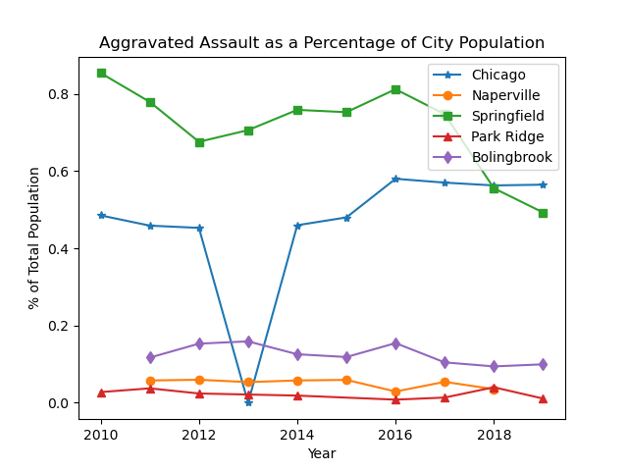
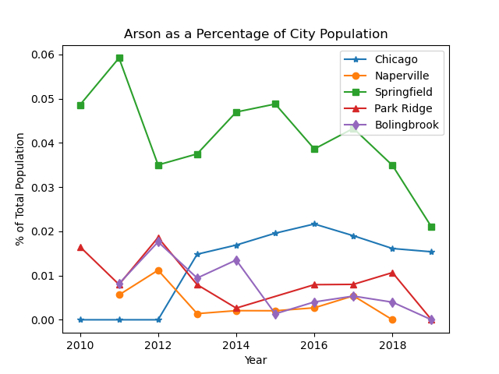

Slide 7
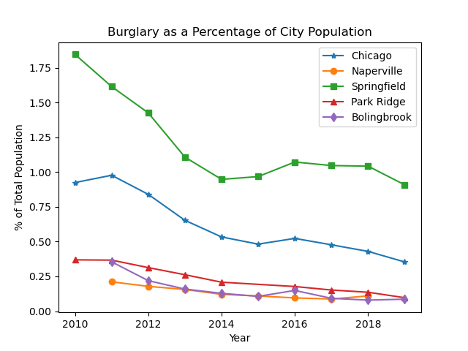
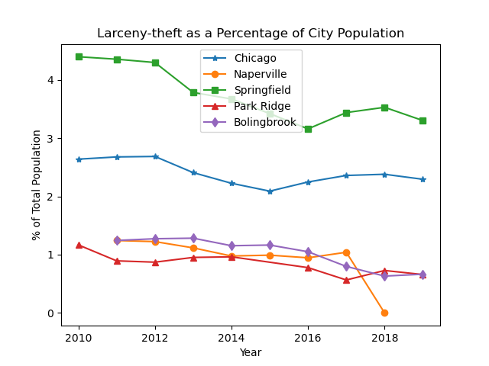

Slide 8
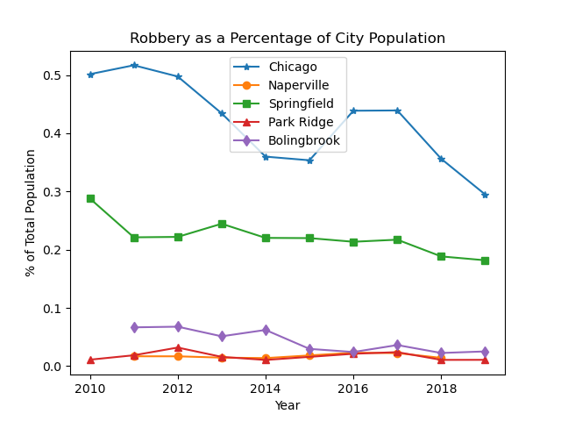
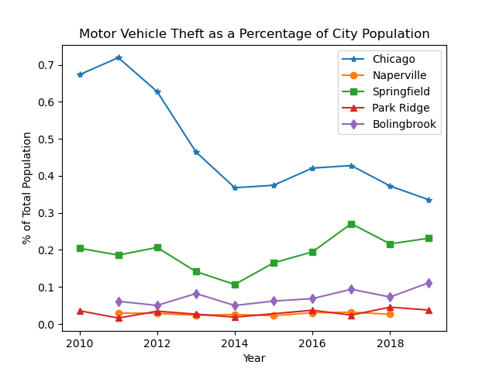

Slide 9
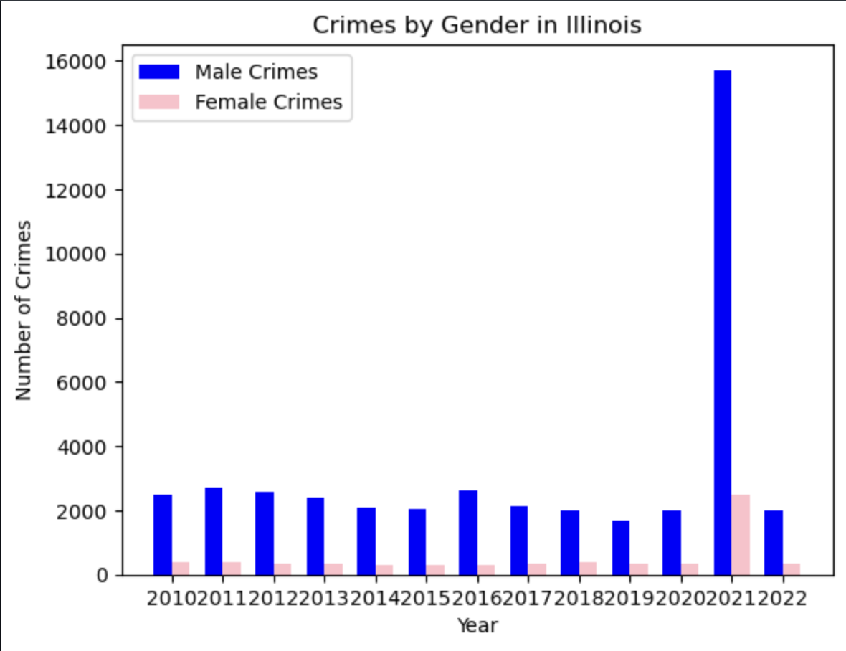
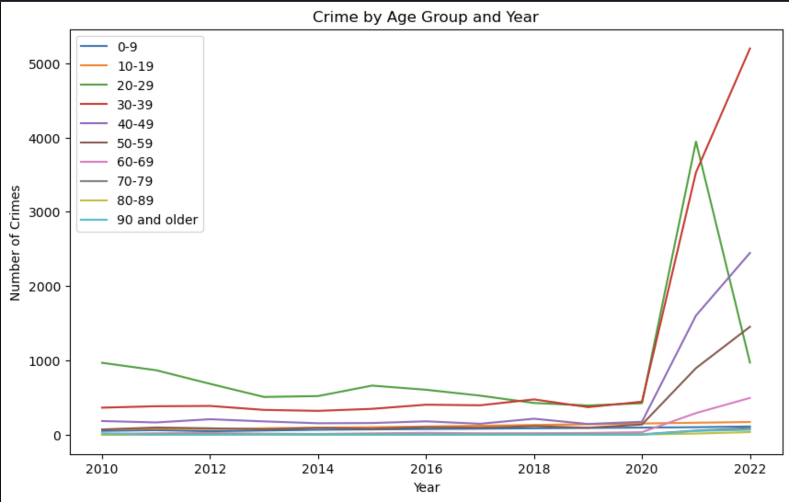
Crime by Gender and Age Group

Slide 10
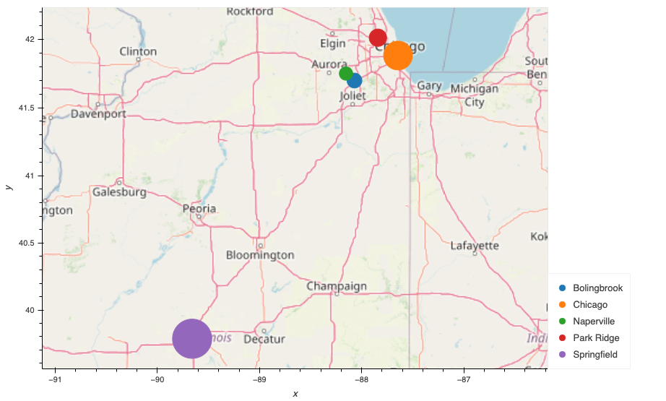
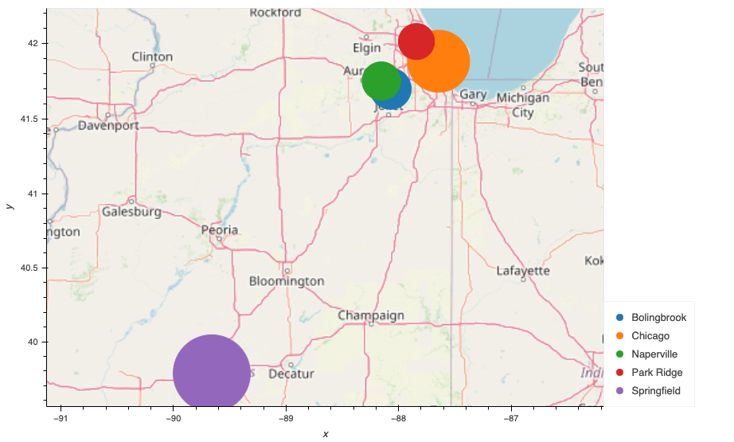
Crime rates per city
Larceny Theft
Burglary
Springfield
Bolingbrook
Park Ridge
Springfield
Park Ridge
Naperville
Chicago
Naperville
Chicago
Bolingbrook

Slide 11
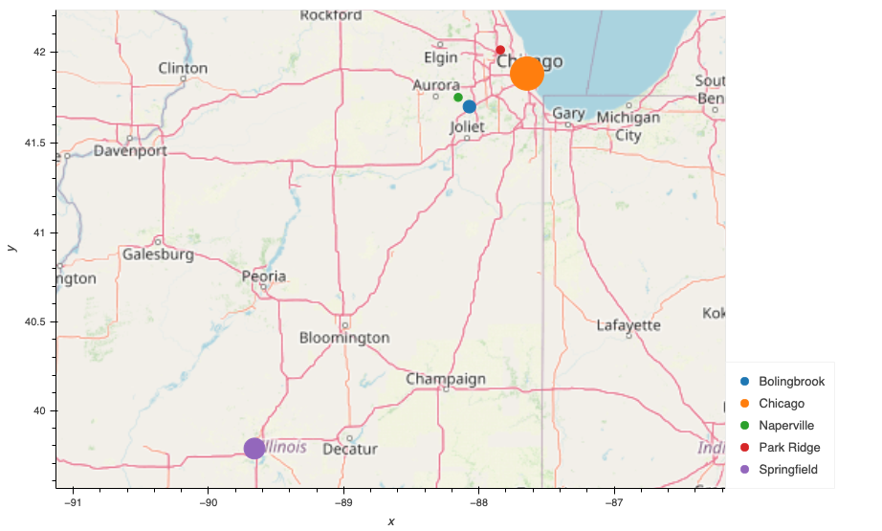

Motor Vehicle Theft
Robbery
Springfield
Bolingbrook
Park Ridge
Springfield
Bolingbrook
Park Ridge
Chicago
Naperville
Chicago
Naperville

Slide 12

Rape
Crime Rate Rank
No.1
Robbery Motor-Vehicle-Theft
No.2
Rape Larceny-theft Burglary
Chicago
No.1
Burglary
No.3
Rape Larceny-theft Robbery Motor-Vehicle-Theft
Bolingbrook
No.1
Rape Larceny-theft Burglary
No.2
Robbery Motor-Vehicle-Theft
Springfield
No.3
Burglary
No.4
Robbery Motor-Vehicle-Theft
Park Ridge
No.5
Rape Larceny-theft
No.4
Rape Larceny-theft
No.5
Burglary Robbery Motor-Vehicle-Theft
Springfield
Chicago
Bolingbrook
Naperville
Park Ridge
Naperville

Slide 13
Additional Information
Sources
www.PoliceFundingDatabase.org
ucr.fbi.gov
catalog.data.gov
data.world
kaggle.com
illinoiscomptroller.gov
www.idoc.illinois.gov
chatGBT
www.google.com (including google maps)
Challenges
State Budget vs. City Budget
City demographics about crimes
Gender/Race/Age
Future Analysis
Educational programs which we wanted to include to show what cities are trying to educate their residents/emergency personnel in order to reduce crime
How much is spent on EMS services per crime
Weather/Temperature correlation to crimes
COVID-19 effect on crime rates

